Slide 1
Analyzing Performance YOLOv8 in Detection,Amount, and Type of Acne Lesions
Devi Zahra Aulia; Putu Harry Gunawan; I Wayan Palton Anuwiksa; Narita Aquarini; Ida Ayu Manik Partha Sutema.
School of Computing
Telkom University
Camera view

Slide 2
Outline
Introduction
Methodology
Result and evaluation result
Conclusion
Camera view

Slide 3
Introduction
Acne is one of the most common skin diseases and usually appears on the facial area caused by oily skin conditions and excessive pores.
The appearance of acne can interfere with a person's psychology such as depression, anxiety, fear, low self-esteem, and shame which can lead to suicidal tendencies¹.
Traditional methods have an error rate in the diagnosis process due to the similarity between one type of acne and another².
To produce a correct diagnosis, a more advanced methodology is needed, such as detecting acne types with deep learning (YOLO)³.
¹ U. Khalid, L. Chen, A. A. Khan, and F. Mehmood, “D-gan: Anautomatic acne detection, severity, and assessment framework usinggenerative adversarial network with deep neural network,” 2024.
² H. Zhang and T. Ma, “Acne detection by ensemble neural networks,”Sensors, vol. 22, no. 18, p. 6828, 2022.
³ J. Wang, C. Wang, Z. Wang, A. H. Hounye, Z. Li, M. Kong,M. Hou, J. Zhang, and M. Qi, “A novel automatic acne detectionand severity quantification scheme using deep learning,” BiomedicalSignal Processing and Control, vol. 84, p. 104803, 2023.
Camera view

Slide 4
YOLOv4 : Archieved 91.25% accuracy in facial acne detection⁴.
YOLOv8 : Archieved 93% accuracy in helmet violation detection⁵.
YOLOV8 can detect object in realtime and detect very small & complex objects^{4,5}.
YOLOv8 can do multiple task at once⁵.
This research employs YOLOv8 for detection acne, amount of acne, and type of acne.
This research resulted in a bounding box and labeling for each of the bounding boxes.
Camera view
⁴ N. A. M. Isa and N. N. A. Mangshor, “Acne type recognitionfor mobile-based application using yolo,” in Journal of Physics:Conference Series, vol. 1962, no. 1. IOP Publishing, 2021, p. 012041.
⁵ A. Aboah, B. Wang, U. Bagci, and Y. Adu-Gyamfi, “Real-timemulti-class helmet violation detection using few-shot data samplingtechnique and yolov8,” in Proceedings of the IEEE/CVF conferenceon computer vision and pattern recognition, 2023, pp. 5350–5358.

Slide 5
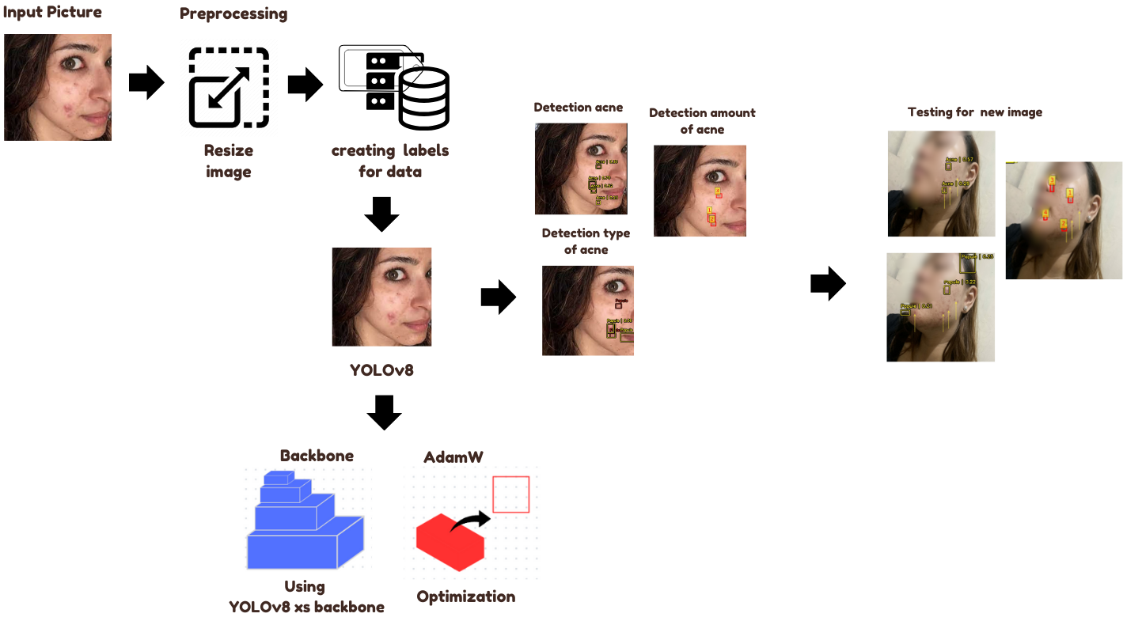
Methodology
This study use 938 data; 823 for data train, 59 for data valid, and 56 for data test.
Dataset was retrieved from Kaagle and saved to google drive.
The dataset consists of only one type of category, namely acne, which will be relabeled into five categories: blackheads, whiteheads, nodule, papule, and pustule.
For detection of acne and the amount of acne, it uses the full of dataset, but to detect the type of acne, it only uses 222 image of 130 images for train data, 47 images for valid data, and 45 images for test data.
User can perform detection with images already entered into the system.
Camera view

Slide 6
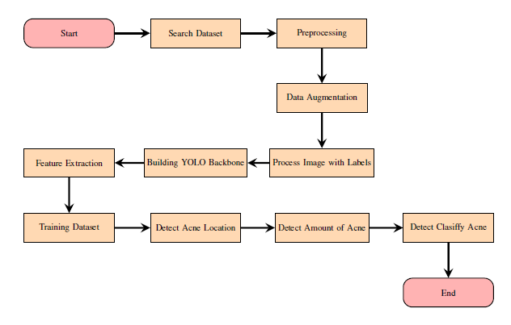
Data Collection: Sourced facial images of acne patients.
Preprocessing: Images undergo resizing, normalization, and augmentation to ensure consistency and improve detection.
Model Configuration: YOLOv8 is customized for the acne detection task.
Acne Detection: Acne lesions are localized and labeled as acne.
Acne count detection: Acne detection is performed and each detected bounding box is labeled with a number.
Acne type detection: Acne are localized and categorized (blackheads, whiteheads, nodules, papules, and pustules).
Camera view

Slide 7
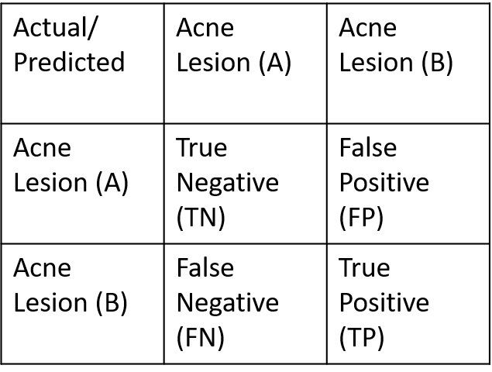
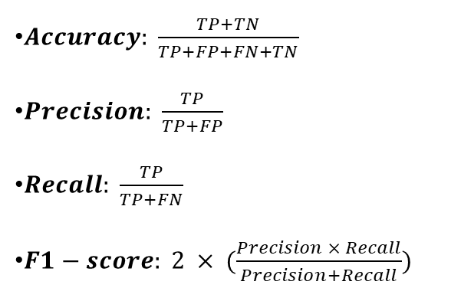
Hyperparameter Overview
Evaluation Metrics
Detection | Learning rate | Weigth | Global clipnorm | Epoch
Acne | 0.0007 | 0.0009 | 10.0 | 140
Amount of acne | 0.0007 | 0.0009 | 10.0 | 140
Type of acne | 0.0007 | 0.0009 | 5.0 | 140
$Accuracy: \frac{TP+TN}{TP+FP+FN+TN}$
$Precision: \frac{TP}{TP+FP}$
$Recall: \frac{TP}{TP+FN}$
$F1−score: 2 × (\frac{Precision × Recall}{Precision+Recall})$
There is a difference value of global clipnorm in acne type detection because when using the same value, there will be overfitting.
Camera view

Slide 8
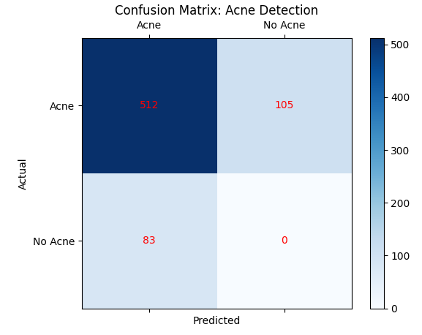
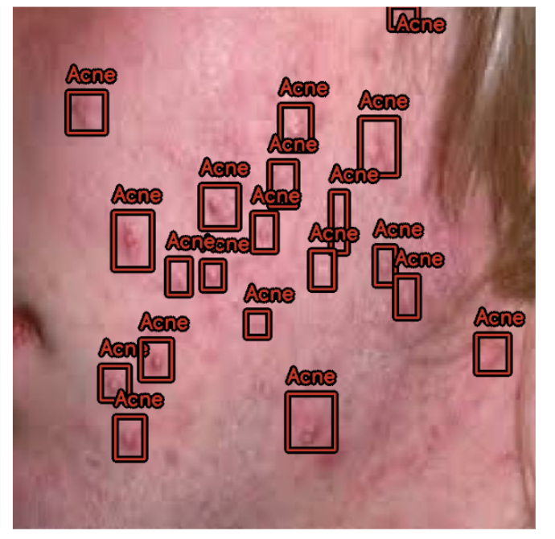
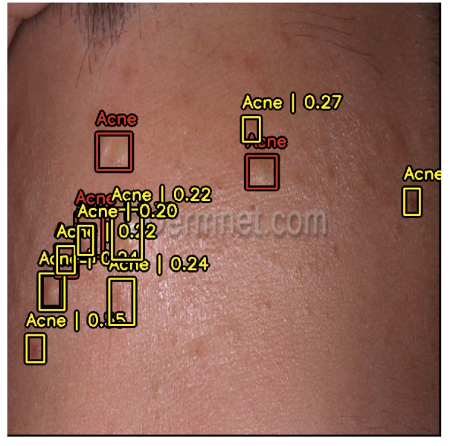
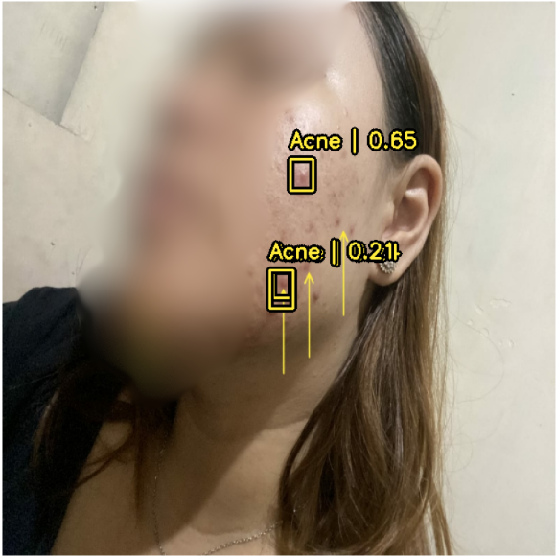
Result and Evaluation Result
Location of Acne
Actual bounding box
Predict bounding box
Detection result
Metric | Value
Accuracy | 0.89
Precision | 0.82
Recall | 0.89
F1-Score | 0.85
Detection | Detection result
Acne | 3 acnes
Camera view

Slide 9
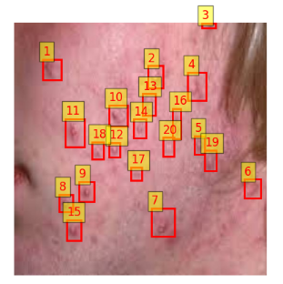
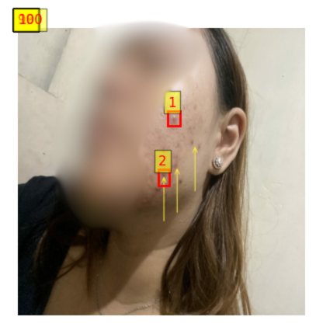
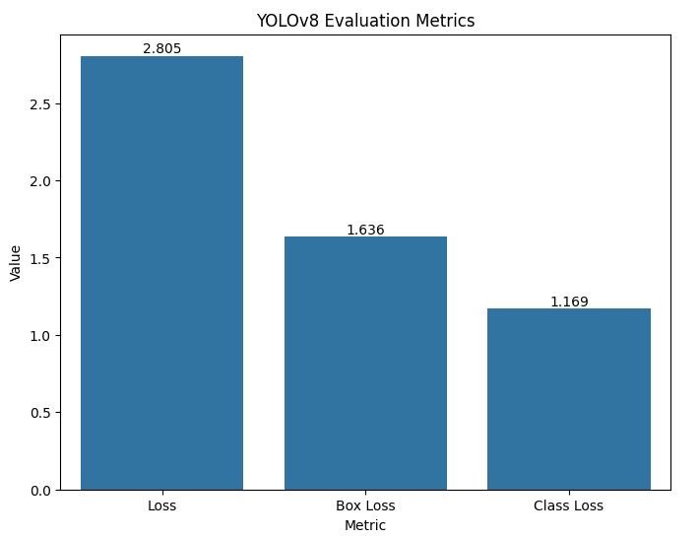
B. Amount of Acne
Metric | Value
Accuracy | 0.82
Precision | 0.80
Recall | 0.82
F1-Score | 0.81
Actual & Prediction bounding box
Detection result
Detection | Detection result
Amount of acne | 100
The results detected a total of 100 acne pimples, but the image only had 2 acne right in the facial area as the rest were outside the facial area.
Camera view

Slide 10
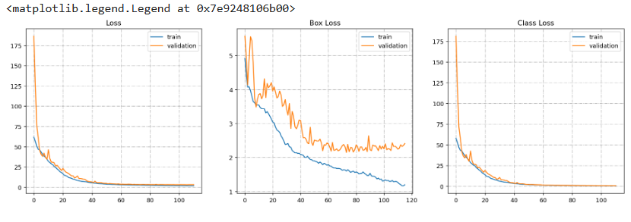
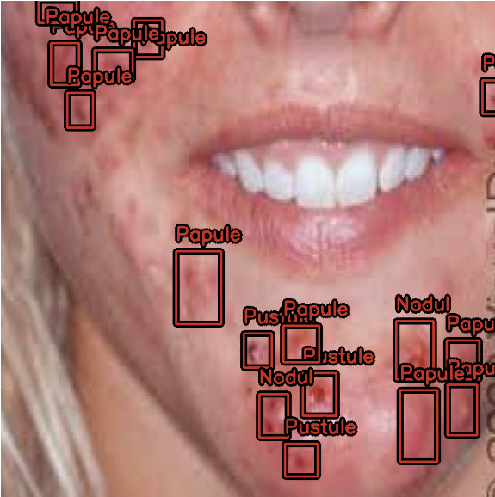
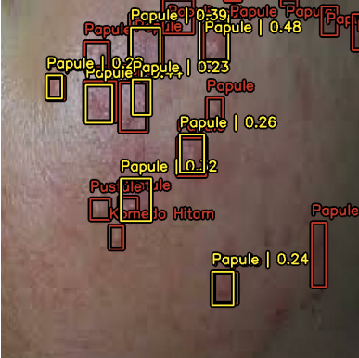
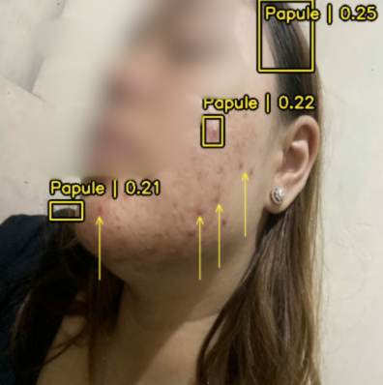
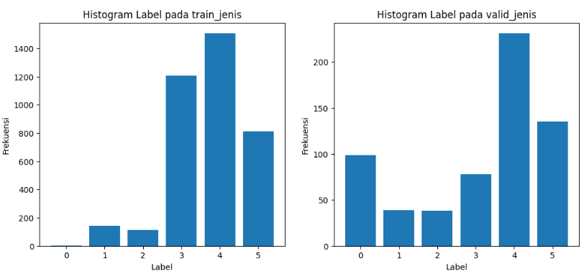
C. Type of Acne
Actual bounding box
Predict bounding box
Detection result
Detection | Detection result
Type of acne | 3 acnes of papule
Metric | Value
Accuracy | 0.49
Precision | 0.72
Recall | 0.49
F1-Score | 0.58
The YOLOv8 model does not understand other variations of acne types due to the imbalance in the labels that only detect the majority class and the minority class is not properly detected.
Camera view

Slide 11
Conclusion
The results of this study show that the YOLOv8 model has 3 accuracies : 89% for acne detection, 82% for detection of the amount of acne , and 49% for detection of acne type.
The Yolov8 model does not perform well in acne type detection due to the imbalance in the dataset, especially the dominance of acne types on the label (papules). This imbalance affects the model's ability to recognize minority acne types.
Other than data imbalance, other factors such aslack of lighting, low image resolution, environmental conditions that hinder the effectiveness of the model.model, and the use of inappropriate hyperparameters.
Solutions include expanding the dataset, performing label equalization, improving the quality of the lighting imageand resolution, fine-tune hyperparameters, and improve the data augmentation process so that the model can handle various skin conditions.
Camera view

Slide 12
Thank You For Listening
Camera view

